Slide 1
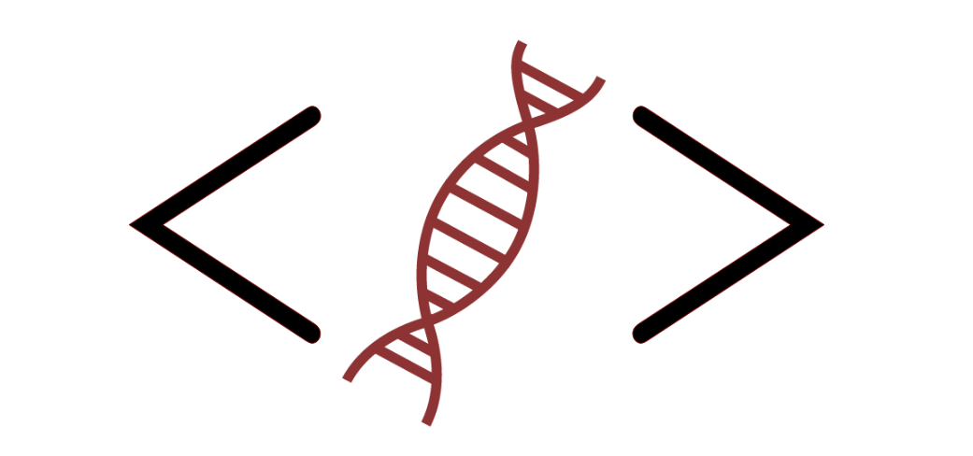
Bioinformatics Bootcamp
Beginner Workshop: “R for Biologists”
Module 1: Orientation and Setting up R

Slide 2
Workshop Orientation

Slide 3
Why a workshop?

Slide 4
Why a workshop?
Those who know programming/bioinformatics will be…

Slide 5
Why a workshop?
Those who know programming/bioinformatics will be…
More effective at research

Slide 6
Why a workshop?
Those who know programming/bioinformatics will be…
More effective at research
More competitive for jobs/funding

Slide 7
Why a workshop?
Those who know programming/bioinformatics will be…
More effective at research
More competitive for jobs/funding
More flexible/adaptable to changes in their field

Slide 8
Why a workshop?
Those who know programming/bioinformatics will be…
More effective at research
More competitive for jobs/funding
More flexible/adaptable to changes in their field
There is tremendous interest in formal bioinformatics training... yet, opportunities for such training are sparse.

Slide 9
Why a workshop?
Those who know bioinformatics will be…
More effective at research
More competitive for jobs/funding
More flexible/adaptable to changes in their field
There is tremendous interest in formal bioinformatics training... yet, opportunities for such training are sparse.
Solution: Provide workshops open to all!

Slide 10
Workshop Structure
Most sessions will be roughly 2:1 lecture and hands-on activities.

Slide 11
Workshop Structure
Most sessions will be roughly 50:50 lecture and hands-on activities.
***Lectures will be recorded***

Slide 12
Workshop Structure
Most sessions will be roughly 50:50 lecture and hands-on activities.
***Lectures will be recorded***
Post questions in the chat

Slide 13
Workshop Structure
Most sessions will be roughly 50:50 lecture and hands-on activities.
***Lectures will be recorded***
Post questions in the chat
Outline
Module 1: Orientation and setting up R
Module 2: Data structures in R
Module 3: Fundamental programming concepts in R
Module 4: Review week
Module 5: The Tidyverse
Module 6: R for biological data science

Slide 14
Learning goals and objectives
From this workshop, you will learn the following topics:
Data structures
Plotting
Reading/writing files
Conditional logic & control flow
Function definitions
Data processing pipelines with tidyverse

Slide 15
Learning goals and objectives
From this workshop, you will learn the following topics:
Data structures
Plotting
Reading/writing files
Conditional logic & control flow
Function definitions
Data processing pipelines with tidyverse
By the end, you will gain the skills and confidence to use R in your research.

Slide 16
How to succeed in this workshop

Slide 17
How to succeed in this workshop
Complete the assignments in DataCamp

Slide 18
How to succeed in this workshop
Complete the assignments in DataCamp
Pursue outside learning (e.g., codecademy, RStudio books, etc)

Slide 19
How to succeed in this workshop
Complete the assignments in DataCamp
Pursue outside learning (e.g., codecademy, RStudio books, etc)
Communicate with your instructors
Email any time and attend Zoom office hours (listed in the syllabus)

Slide 20

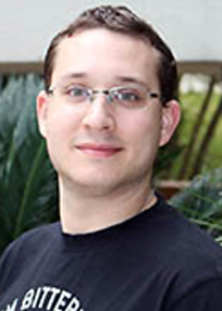

Bioinformatics Bootcamp Instructors
Henry Miller
Simon Levy
Aiola Stoja

Slide 21

About BIG club
Bioinformatics Interest Group (BIG) is a new UT Health SA club promoting student engagement with bioinformatics.
Leadership
President: Muku Bhandari
Vice President: Victoria Alers
Secretary: Paul Ramirez
Training committee chair: Henry Miller
Historian: Aiola Stoja
Treasurer: Meilinn Tram
All UT Health SA students are welcome to join our next meeting Tomorrow from 6:30-7:30pm CST.

Slide 22
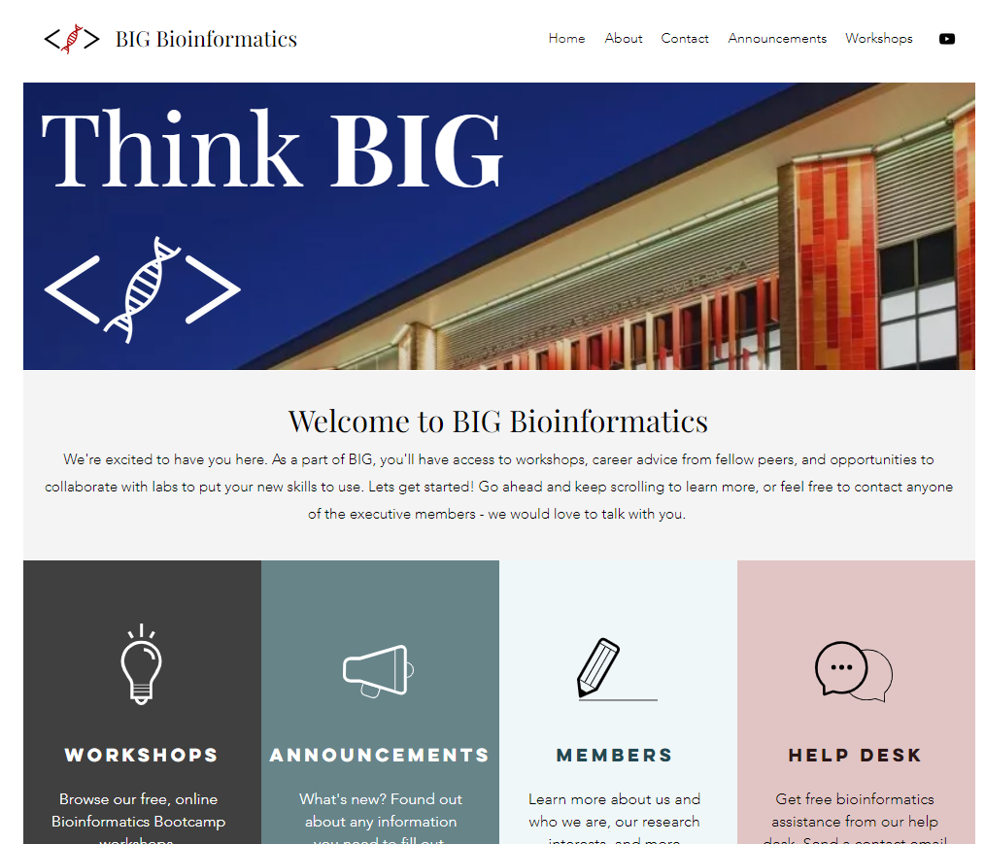
https://www.bigbioinformatics.org/

Slide 23
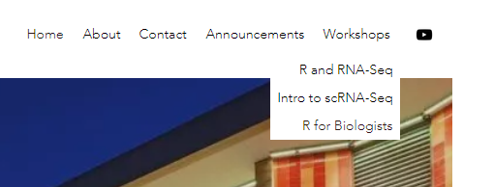
https://www.bigbioinformatics.org/

Slide 24
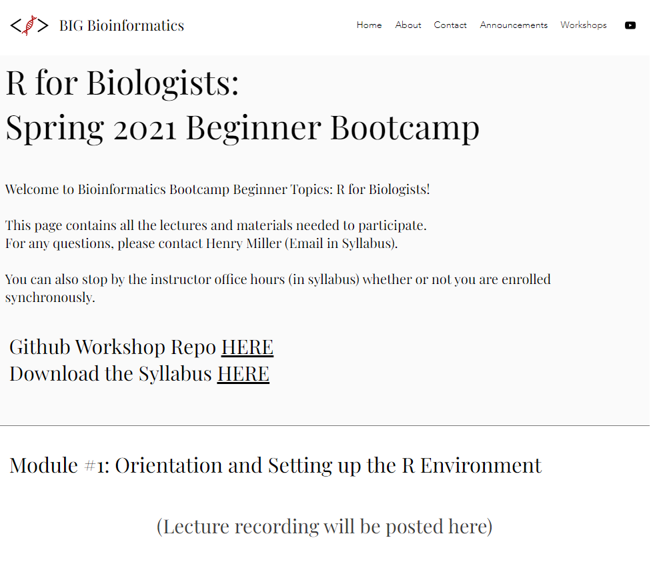
https://www.bigbioinformatics.org/

Slide 25
Introduction
Why should you learn computational biology?

Slide 26
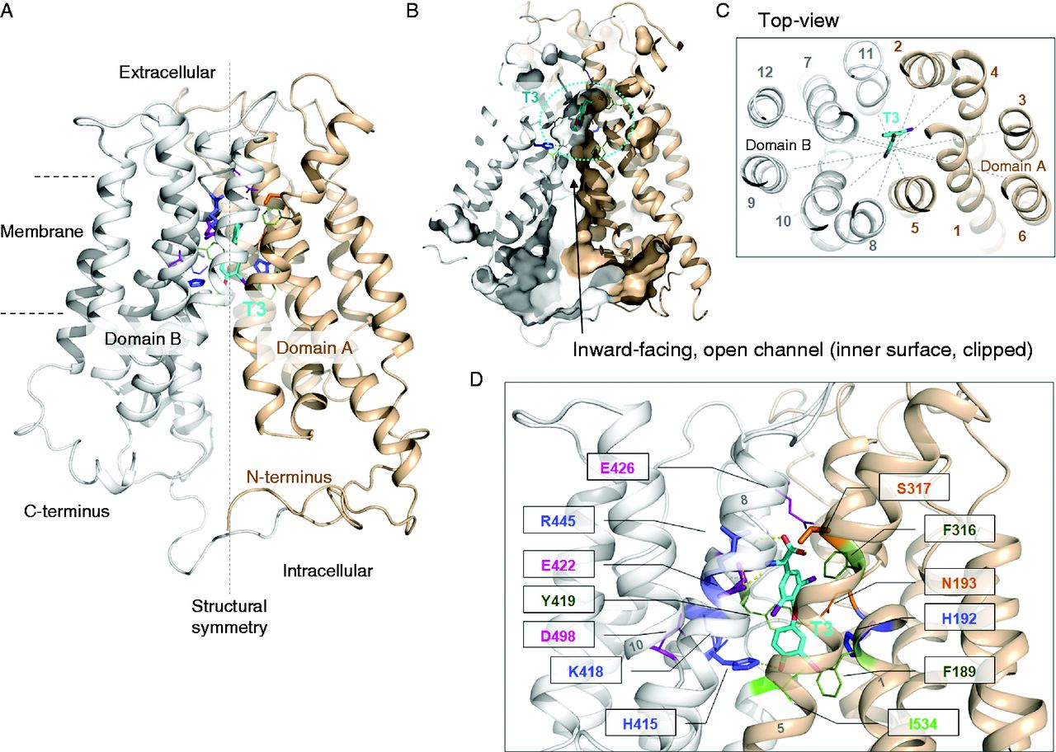
SLC16A2
Fischer J., et al. Modulation of monocarboxylate transporter 8 oligomerization by specific pathogenic mutations. Journal of Molecular Endocrinology. 2015, 54(1):39-50. PubMed ID: 25527620

Slide 27
:(
Fischer J., et al. Modulation of monocarboxylate transporter 8 oligomerization by specific pathogenic mutations. Journal of Molecular Endocrinology. 2015, 54(1):39-50. PubMed ID: 25527620

Slide 28


X

Slide 29
X
☺

Slide 30

…?

Slide 31
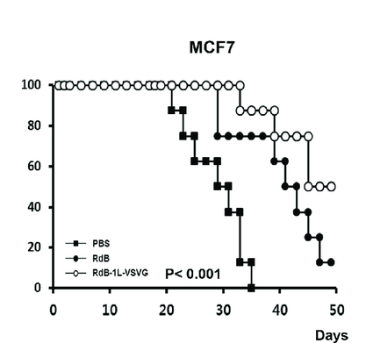

Slide 32
Get the protocol approved
> 2-3 weeks
Get the mice
> 2-3 weeks
Inject & monitor survival
> 8 weeks

Slide 33
…?

Slide 34
> 10-12 weeks

Slide 35
> 10-12 weeks ☹

Slide 36
?

Slide 37
Gepia2 Demo

Slide 38
:(
Fischer J., et al. Modulation of monocarboxylate transporter 8 oligomerization by specific pathogenic mutations. Journal of Molecular Endocrinology. 2015, 54(1):39-50. PubMed ID: 25527620

Slide 39
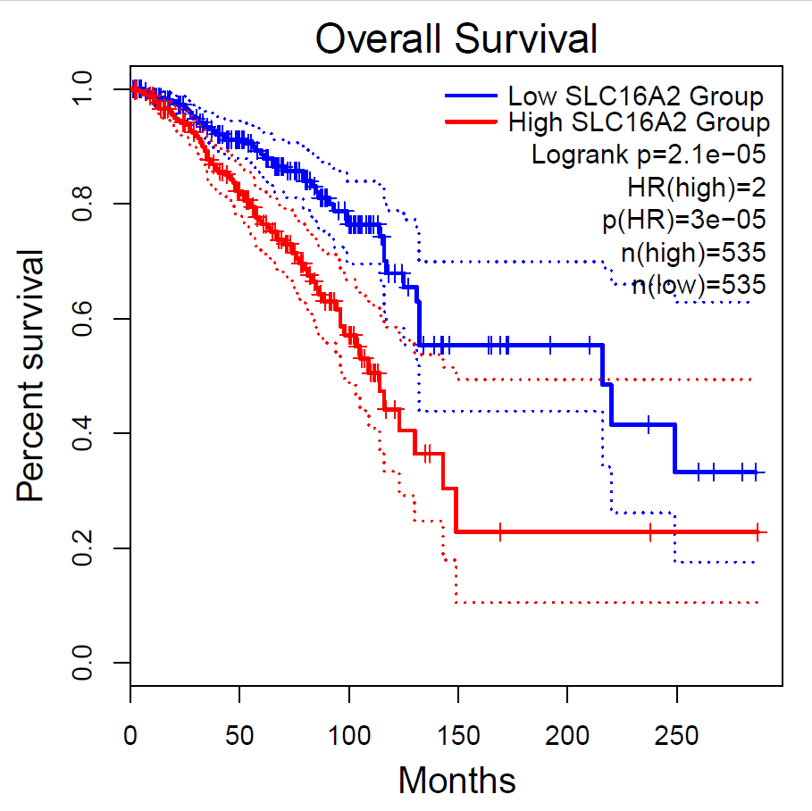

Slide 40
:(
Probably…
Fischer J., et al. Modulation of monocarboxylate transporter 8 oligomerization by specific pathogenic mutations. Journal of Molecular Endocrinology. 2015, 54(1):39-50. PubMed ID: 25527620

Slide 41
> 10-12 weeks

Slide 42
> 10-12 weeks ☺

Slide 43
Without having to set foot in the lab…

Slide 44
Without having to set foot in the lab…
I can (partially) test my hypothesis…

Slide 45
Without having to set foot in the lab…
I can (partially) test my hypothesis…
and decide whether to invest lab-time/money

Slide 46
Without having to set foot in the lab…
I can (partially) test my hypothesis…
and decide whether to invest lab-time/money (and support my next grant…)

Slide 47
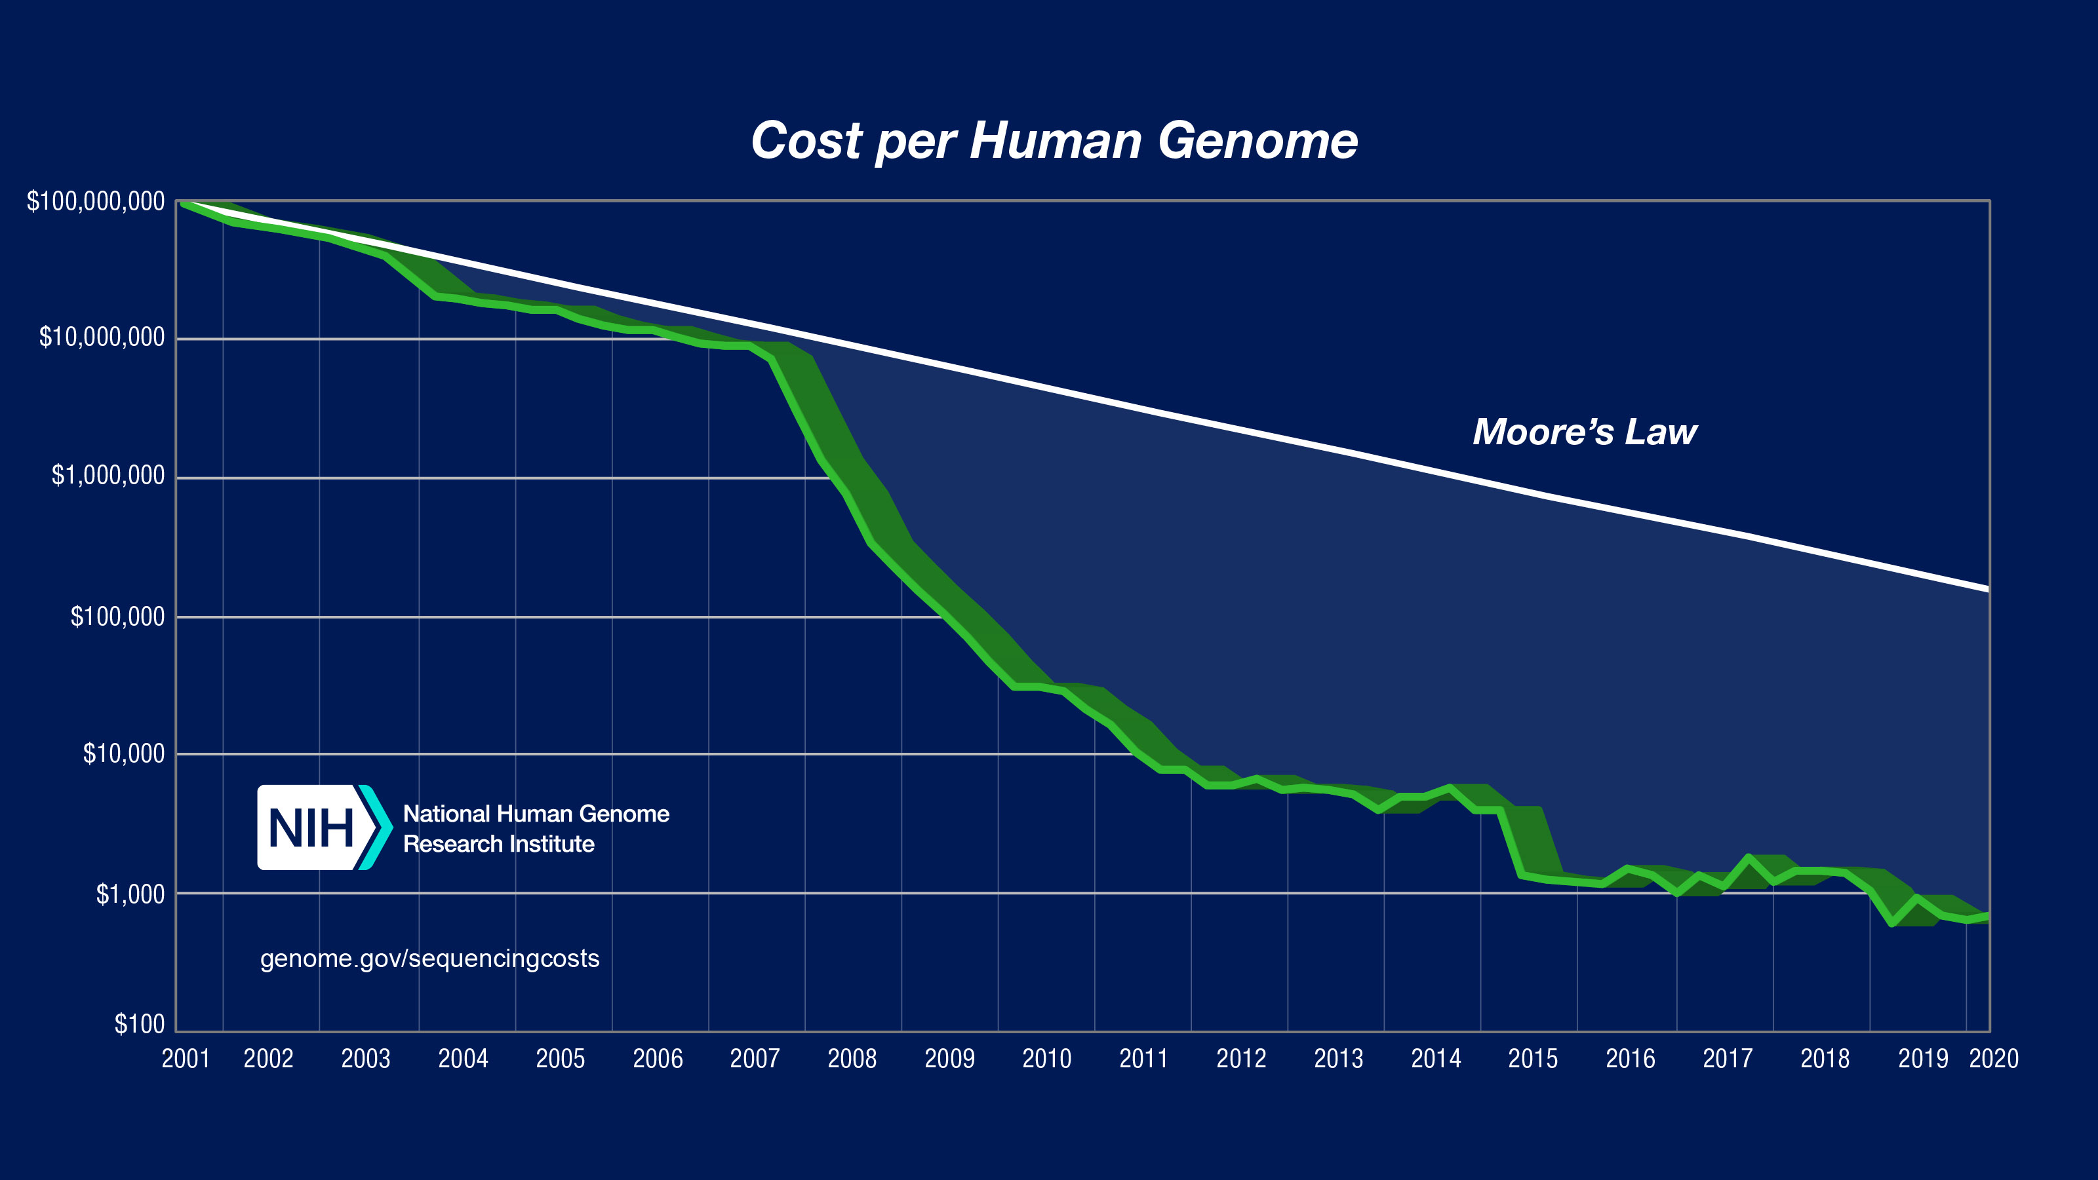
https://www.ncbi.nlm.nih.gov/sra/docs/sragrowth/

Slide 48
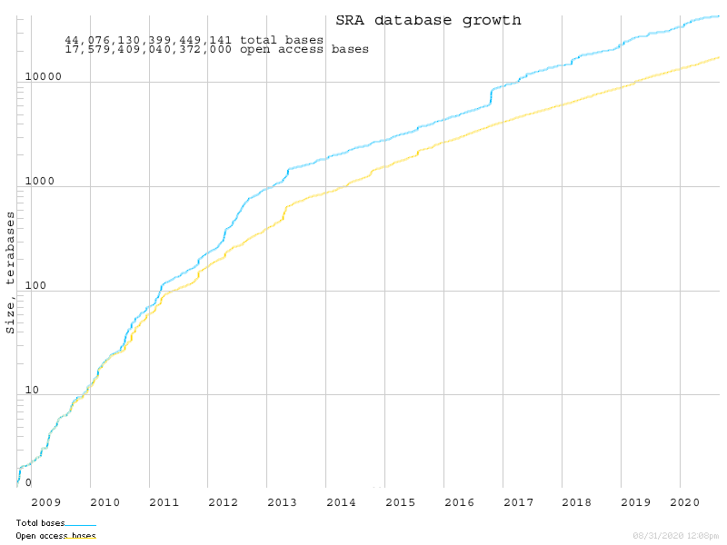
> 11 PB of data!
Log scale…
https://www.ncbi.nlm.nih.gov/sra/docs/sragrowth/

Slide 49
Bioinformatics is open source science

Slide 50
Bioinformatics is open source science
Thousands of public databases

Slide 51
Bioinformatics is open source science
Thousands of public databases
Millions of data samples freely available

Slide 52
Bioinformatics is open source science
Thousands of public databases
Millions of data samples freely available
Code is (usually) freely available

Slide 53
Bioinformatics is open source science
Thousands of public databases
Millions of data samples freely available
Code is (usually) freely available
Training resources are (often) freely available

Slide 54
Bioinformatics is open source science
Thousands of public databases
Millions of data samples freely available
Code is (usually) freely available
Training resources are (often) freely available
Result: Bioinformatics is only becoming bigger and more useful every year because it is (largely) open source

Slide 55
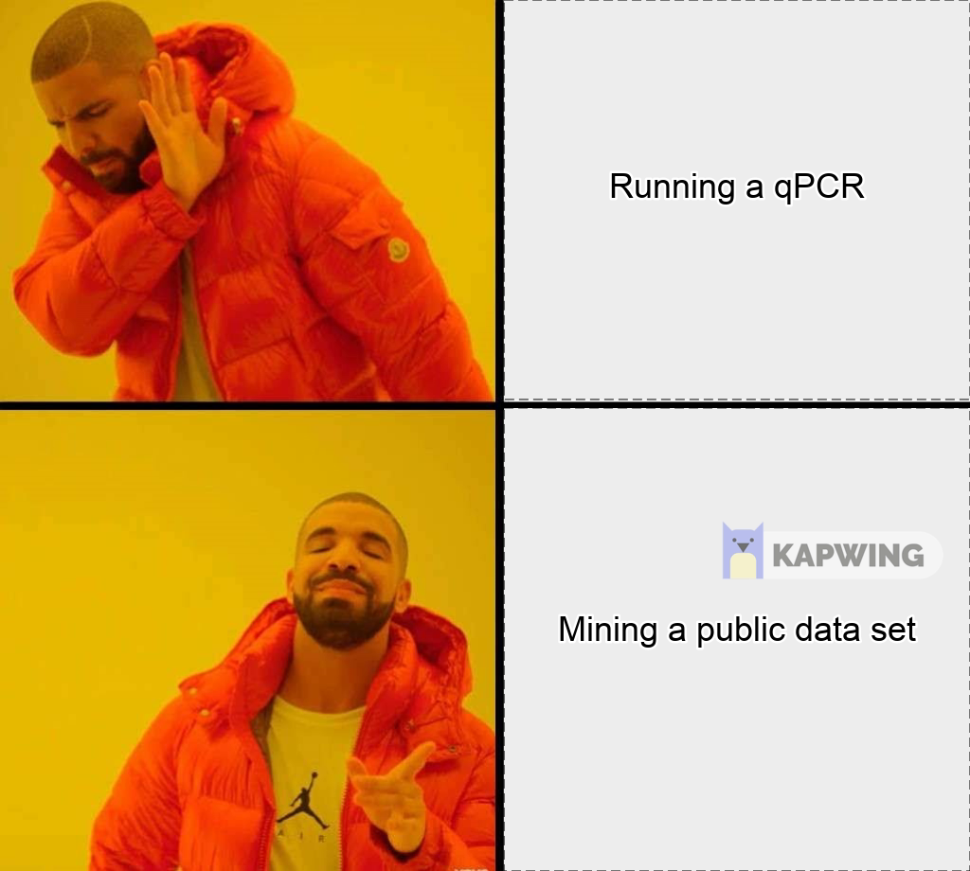
Implications of Open Source Bioinformatics…
Running a qPCR
Mining some public RNA-Seq data

Slide 56
How to learn bioinformatics.

Slide 57
What is bioinformatics?

Slide 58
What is bioinformatics?
Data Science
Comp. Science
Statistics
Bioinformatics
Comp. Biology
Biostatistics
Biology

Slide 59
Bioinformatics can be defined as…
“the application of computational tools to organize, analyze, understand, visualize and store information associated with biological macromolecules”
Bilotta, M., Tradigo, G. & Veltri, P. Bioinformatics Data Models, Representation and Storage. in (eds. Ranganathan, S., Gribskov, M., Nakai, K. & Schönbach, C. B. T.-E. of B. and C. B.) 110–116 (Academic Press, 2019). doi:https://doi.org/10.1016/B978-0-12-809633-8.20410-X.

Slide 60
What is bioinformatics?
Data Science
Comp. Science
Statistics
Bioinformatics
Comp. Biology
Biostatistics
Biology

Slide 61
Bioinformatics can be defined as…
“It’s just data science for biology.”
Just me. (2020). Me, doi: https://me.

Slide 62
How to learn bioinformatics.
TLDR: (1) Learn data science. (2) Use it to answer biological questions.

Slide 63
Step 1: Learn Data Science

Slide 64
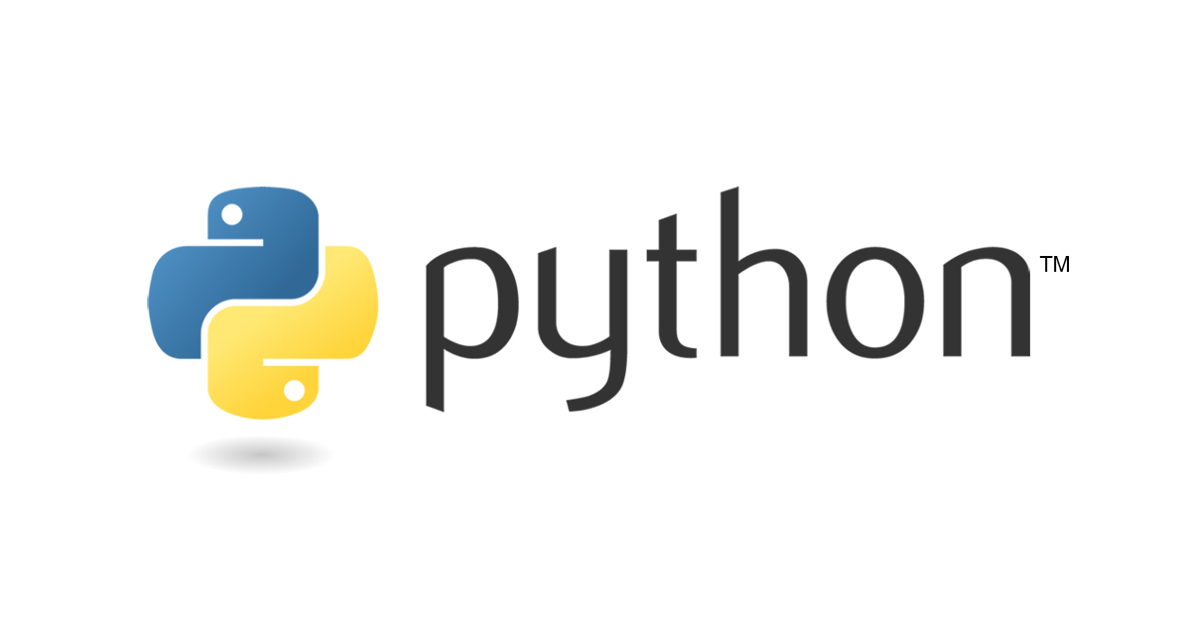



Slide 65




Slide 66
Step 2: Answer biological questions

Slide 67
Step 2: Answer biological questions
Get some data! (Start with RNA-Seq)

Slide 68
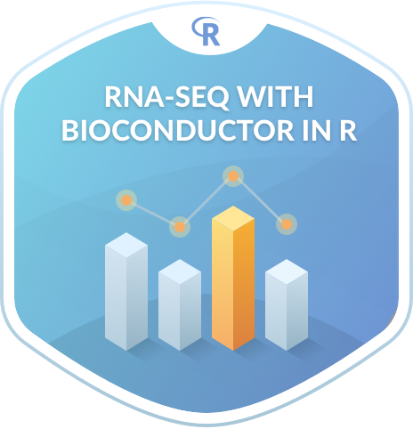

Slide 69



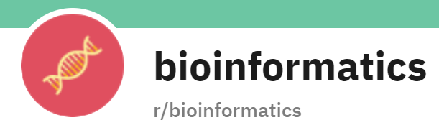


Where to get help

Slide 70
Workshop workflow

Slide 71
R for Biologists Workflow

Slide 72
R for Biologists Workflow
Set up R

Slide 73
R for Biologists Workflow
Set up R
Data Structures

Slide 74
R for Biologists Workflow
Set up R
Data Structures
R programming

Slide 75
R for Biologists Workflow
Set up R
Data Structures
R programming
The Tidyverse

Slide 76
R for Biologists Workflow
Set up R
Data Structures
R programming
The Tidyverse
qPCR Analysis with R

Slide 77
R for Biologists Workflow
Set up R
Data Structures
R programming
The Tidyverse
qPCR Analysis with R
Viral Genome Analysis

Slide 78
R for Biologists Workflow and beyond…
Set up R
Data Structures
R programming
The Tidyverse
qPCR Analysis with R
Viral Genome Analysis

Slide 79
R for Biologists Workflow and beyond…
Set up R
Data Structures
R programming
The Tidyverse
qPCR Analysis with R
Electrophysiology Analysis
RNA-Seq / scRNA-Seq
Protein Interaction network analysis
Drug PK/PD and synergy analysis
Literature Mining
ChIP-Seq / HiC-Seq
Viral Genome Analysis
Structural modeling
Population health
Machine learning
Etc…
Image processing
Clinical data analysis
Things you can do with R

Slide 80
R for Biologists Workflow
Set up R
Data Structures
R programming
The Tidyverse
qPCR Analysis with R
Viral Genome Analysis

Slide 81
R for Biologists Workflow
Set up R
Data Structures
R programming
The Tidyverse
qPCR Analysis with R
Viral Genome Analysis

Slide 82
Introduction to R

Slide 83
What is R?
https://www.r-project.org/

Slide 84
What is R?
Programming language first released in 1995
https://www.r-project.org/

Slide 85
What is R?
Programming language first released in 1995
Open-source derivative of Bell Lab’s “S” language
https://www.r-project.org/

Slide 86
What is R?
Programming language first released in 1995
Open-source derivative of Bell Lab’s “S” language
Features:
https://www.r-project.org/

Slide 87
What is R?
Programming language first released in 1995
Open-source derivative of Bell Lab’s “S” language
Features:
Object oriented
https://www.r-project.org/

Slide 88
What is R?
Programming language first released in 1995
Open-source derivative of Bell Lab’s “S” language
Features:
Object oriented
Interpreted (not compiled!)
https://www.r-project.org/

Slide 89
What is R?
Programming language first released in 1995
Open-source derivative of Bell Lab’s “S” language
Features:
Object oriented
Interpreted (not compiled!)
Designed for statistical computing
https://www.r-project.org/

Slide 90
What is R?
Programming language first released in 1995
Open-source derivative of Bell Lab’s “S” language
Features:
Object oriented
Interpreted (not compiled!)
Designed for statistical computing
Easily extended with packages
https://www.r-project.org/

Slide 91
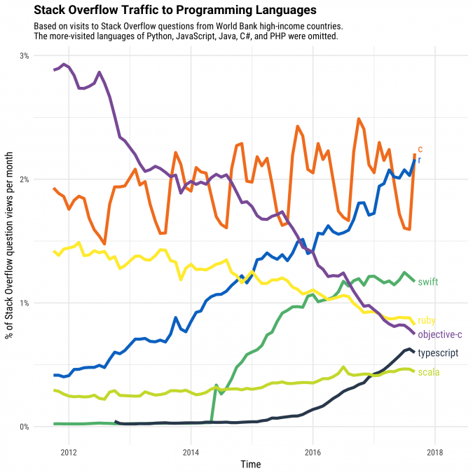
Why learn R?
Up-and-coming language for Data Science
https://stackoverflow.blog/2017/10/10/impressive-growth-r/

Slide 92
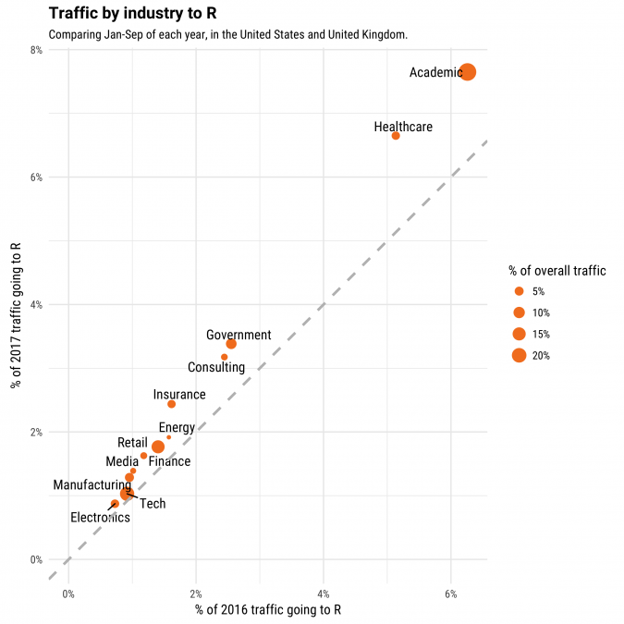
Why learn R?
Academic research is the largest area of R usage
https://stackoverflow.blog/2017/10/10/impressive-growth-r/

Slide 93
R-based Bioconductor is the leading repository of bioinformatics software
https://blog.f1000.com/2016/07/14/going-with-the-workflow-an-interview-with-bioconductor/

Slide 94
R-based Bioconductor is the leading repository of bioinformatics software
Question: Is the popularity of Bioconductor increasing over time?
read_tsv("https://bioconductor.org/packages/stats/bioc/bioc_pkg_stats.tab") %>% filter(Year != 2021) %>% select(Year, Nb_of_downloads) %>% group_by(Year) %>% summarise(sum = sum(Nb_of_downloads) / 1000000) %>% ggplot(mapping = aes(x = Year, y = sum)) + geom_area(fill="#69b3a2", alpha=0.4) + geom_line(color="#69b3a2", size=2) + geom_point(size=3, color="#69b3a2") + scale_x_continuous(breaks = 2009:2020) + theme_ipsum(axis_title_size = 10) + labs(x = NULL, y = "Downloads / year (millions)", title = "Bioconductor package downloads / year over time")

Slide 95
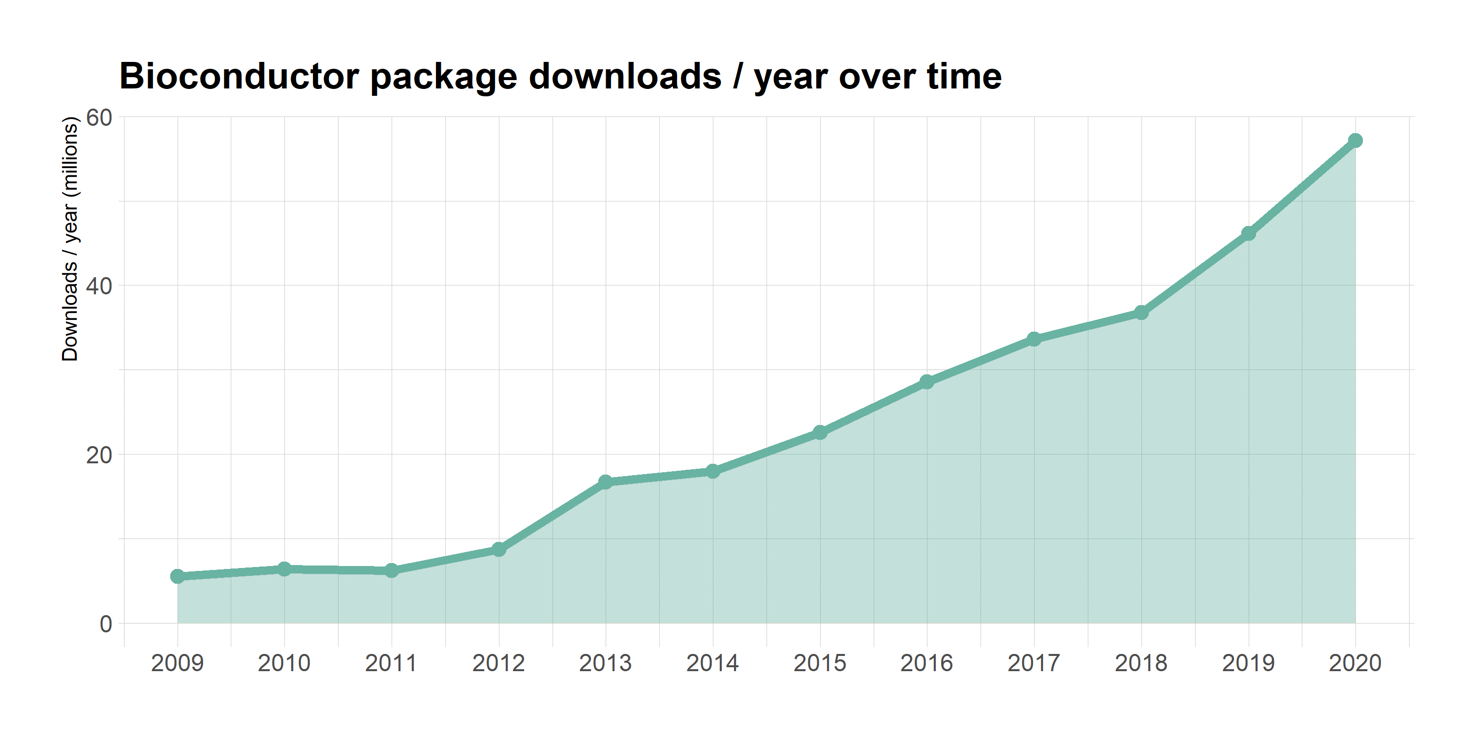
R-based Bioconductor is the leading repository of bioinformatics software

Slide 96
Fine alternatives to R exist
https://juniortech.org/wp-content/uploads/2017/04/python-software-logo.jpg
https://eps.leeds.ac.uk/events/event///5932/how-can-matlab-help-research-workflows

Slide 97
Setting up R

Slide 98
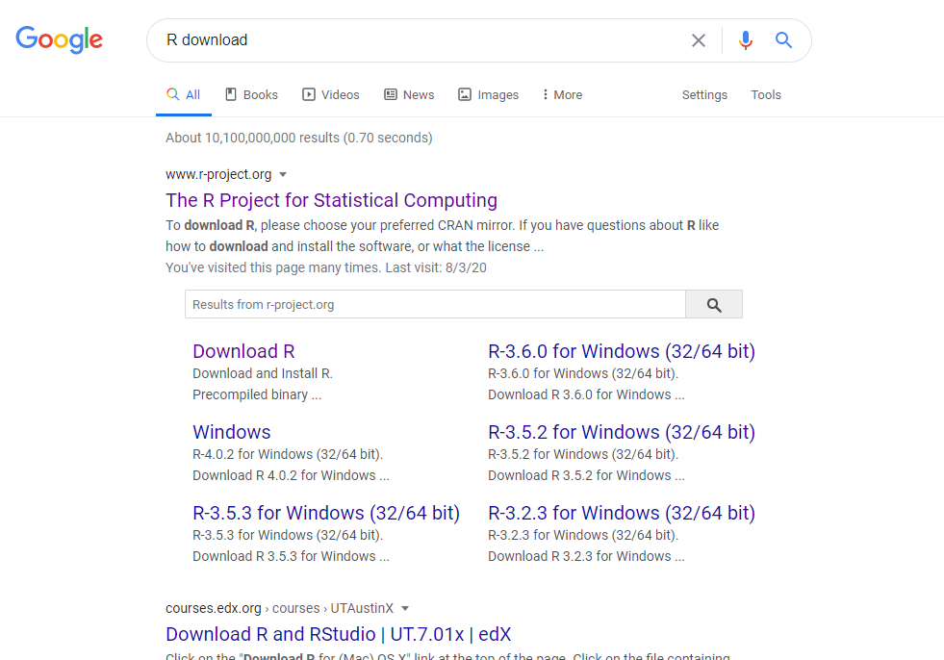

Slide 99
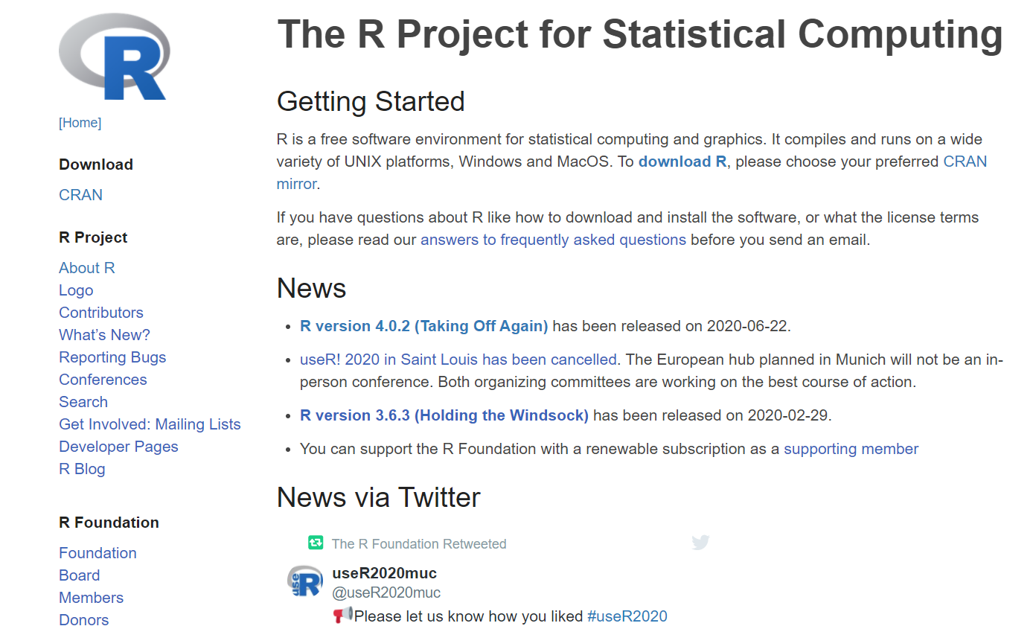

Slide 100
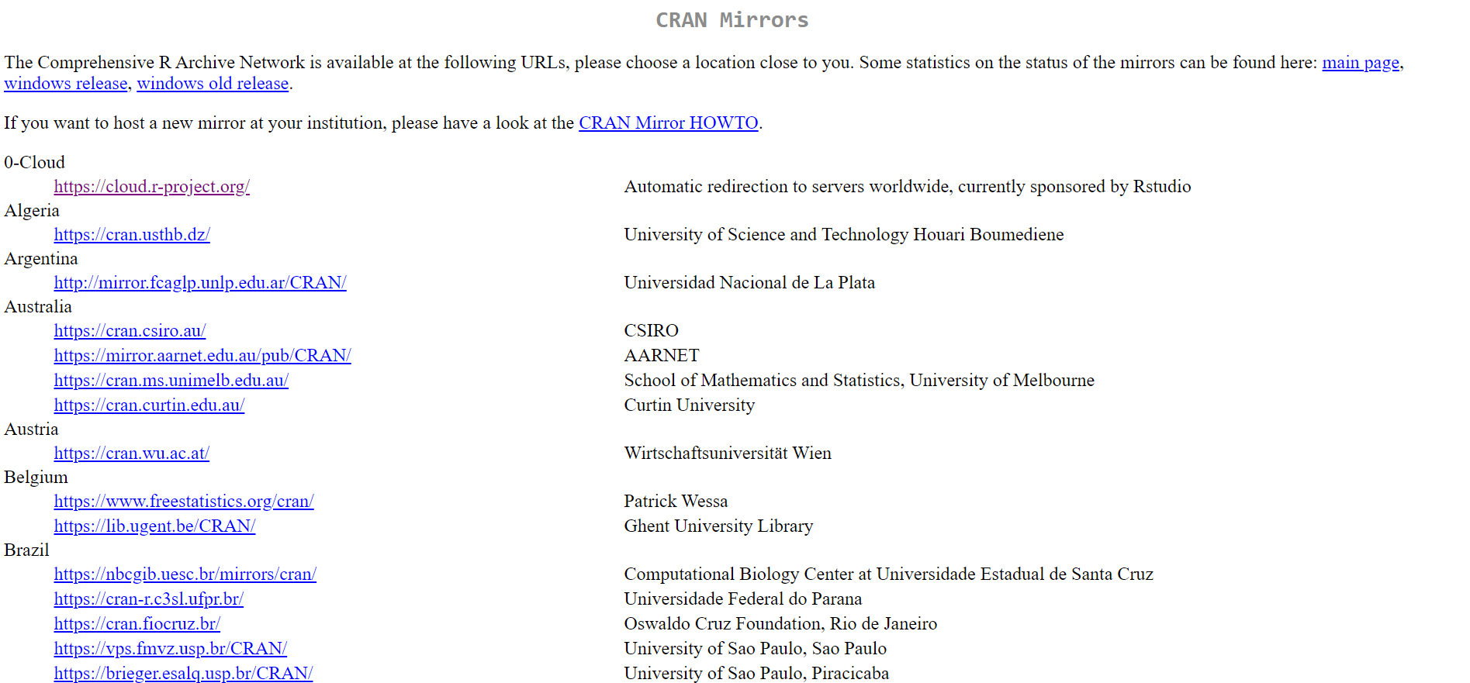

Slide 101
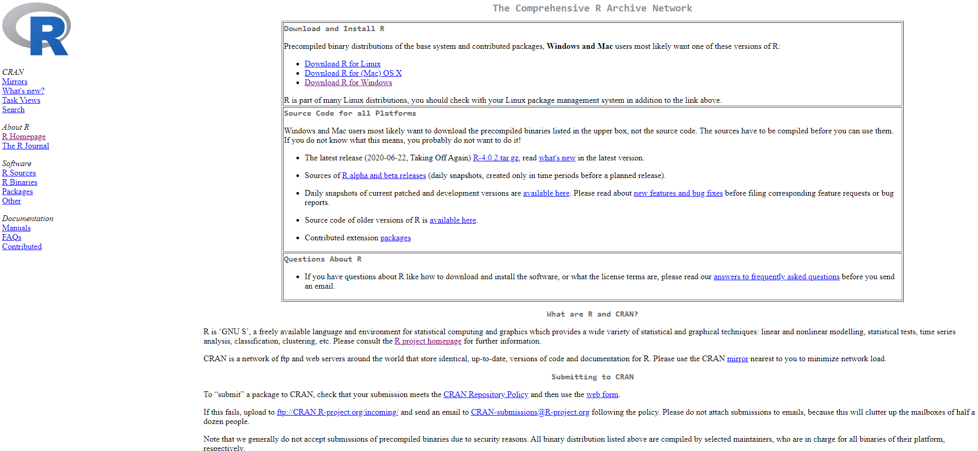

Slide 102
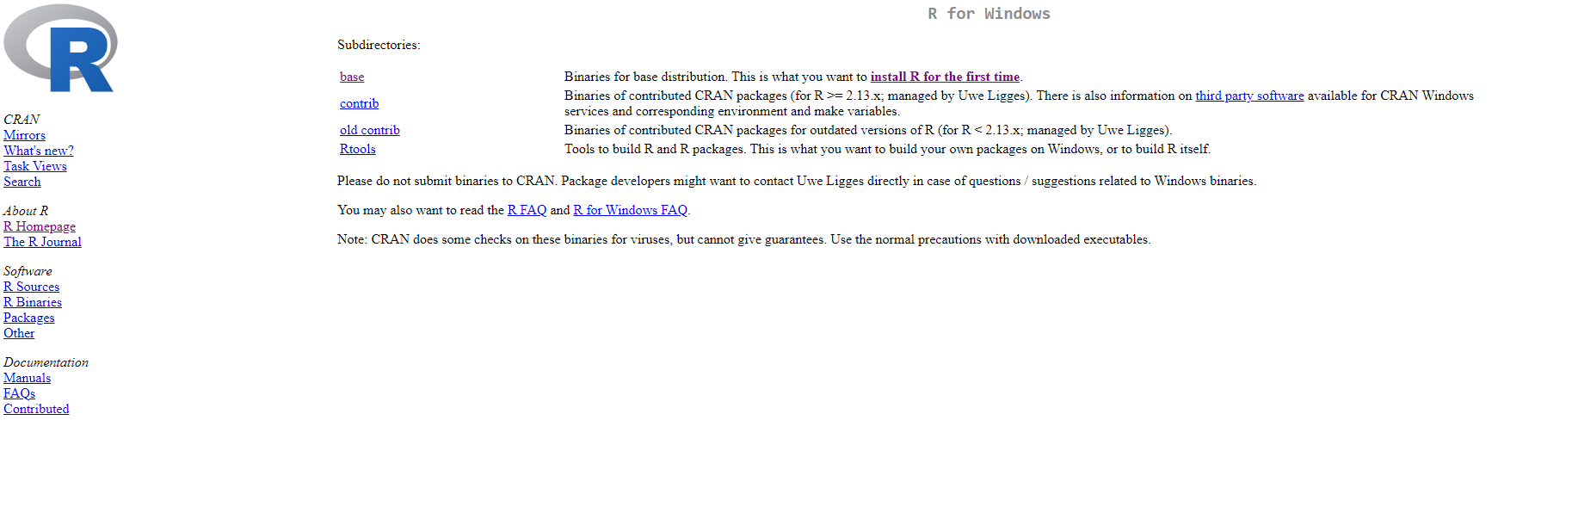

Slide 103
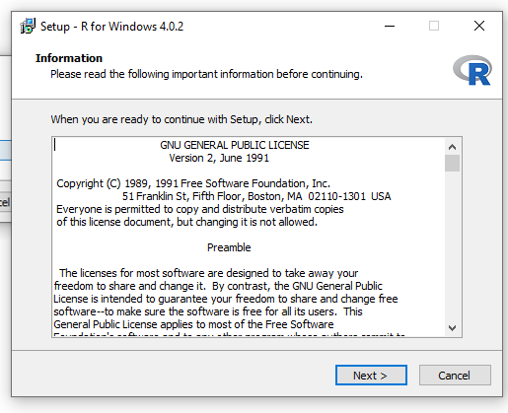

Slide 104
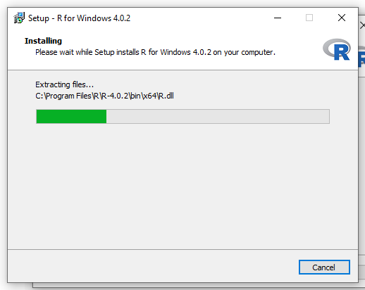

Slide 105
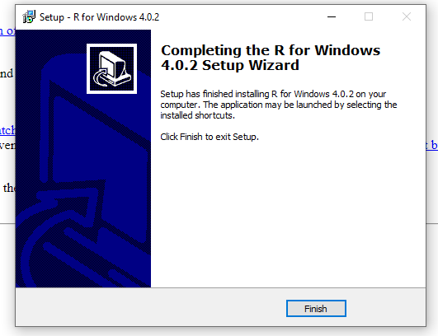

Slide 106
Setting up RStudio

Slide 107
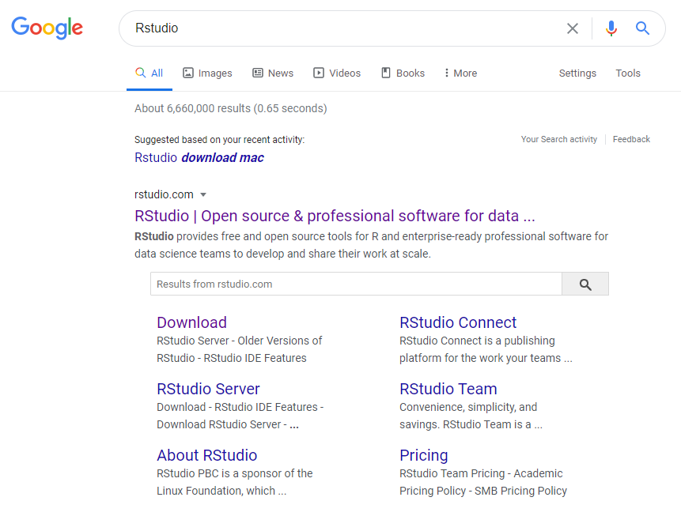

Slide 108
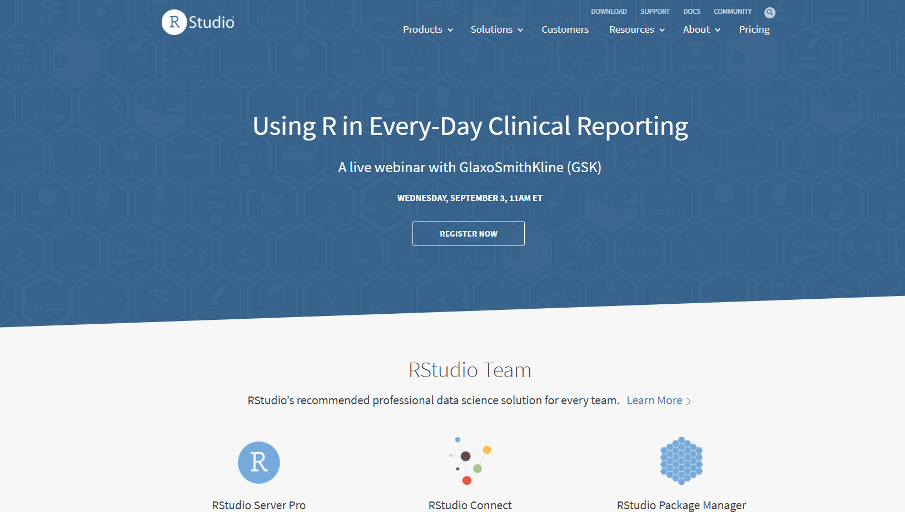

Slide 109
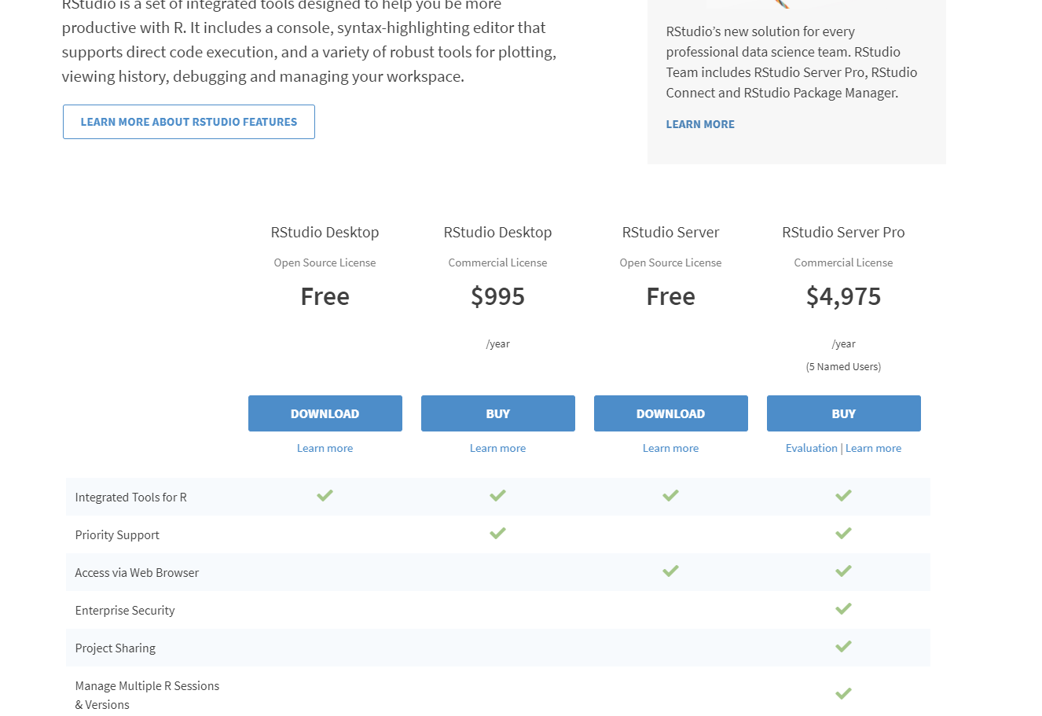

Slide 110
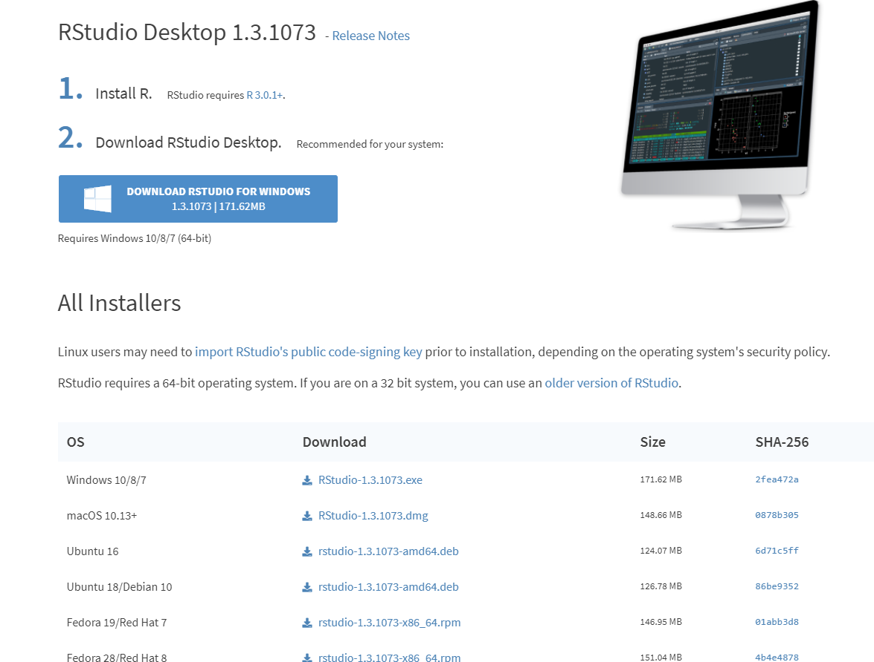

Slide 111
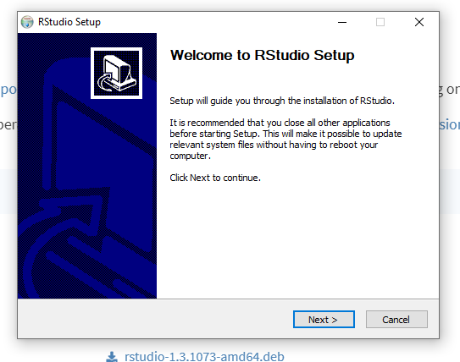

Slide 112
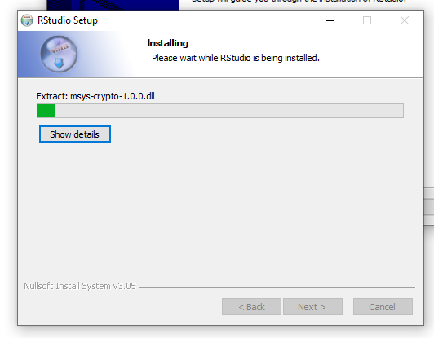

Slide 113
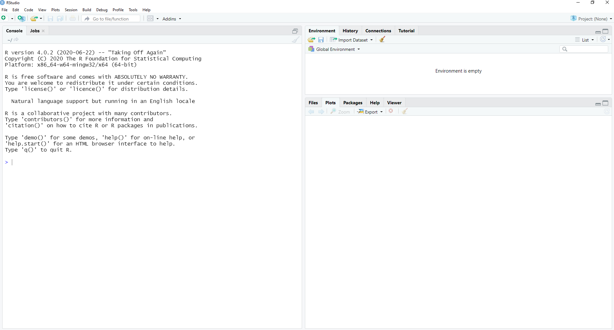

Slide 114
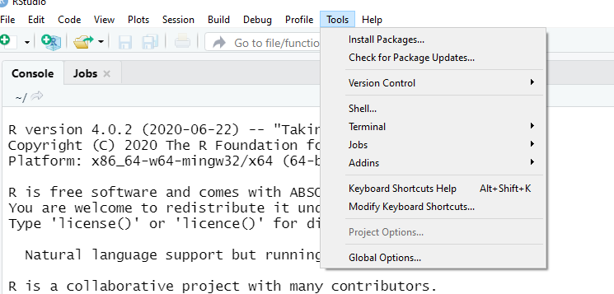

Slide 115
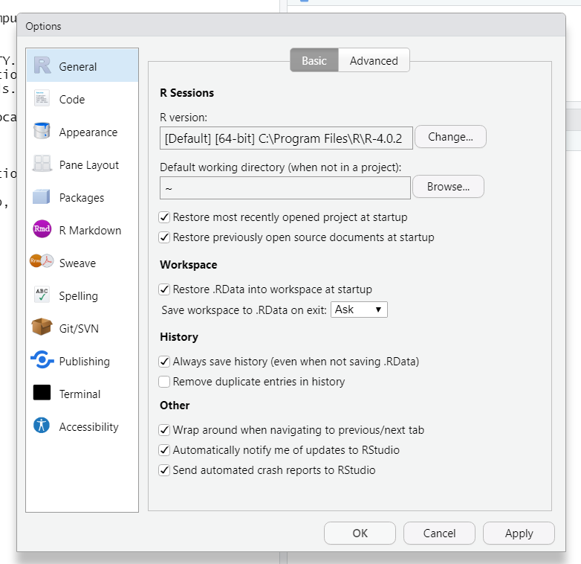

Slide 116
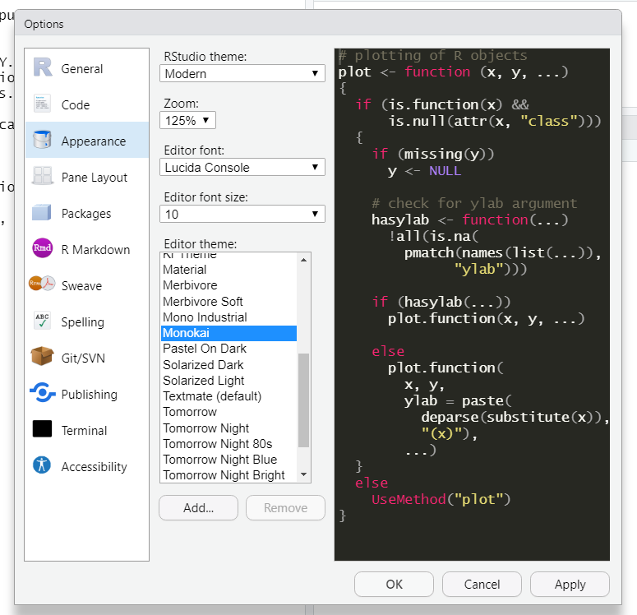

Slide 117
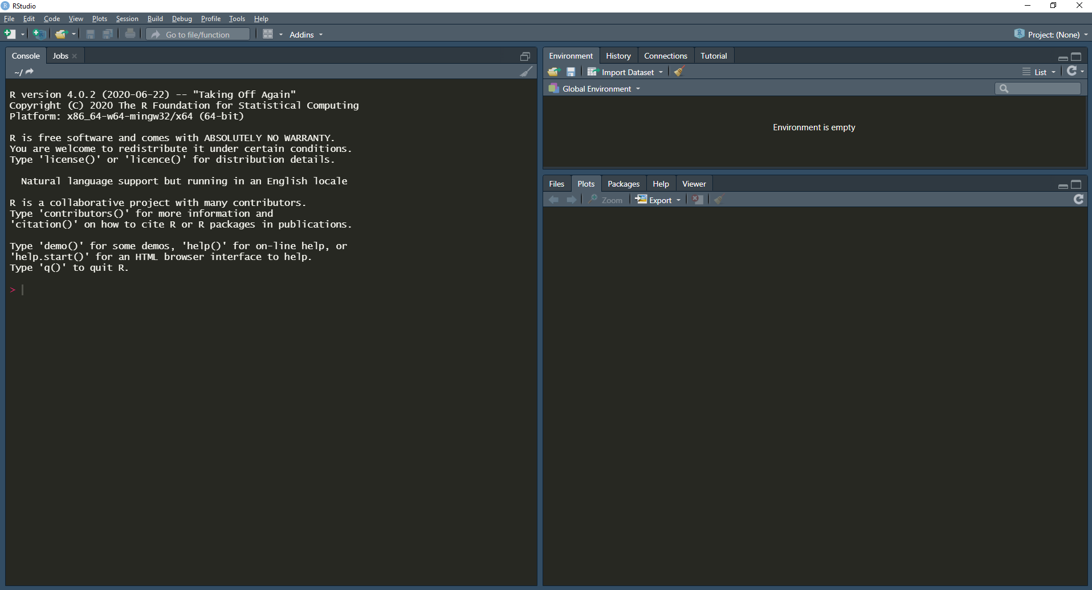

Slide 118
R for Biologists Workflow
Set up R
Data Structures
R programming
The Tidyverse
qPCR Analysis with R
Viral Genome Analysis

Slide 119
R for Biologists Workflow
Set up R
Data Structures
R programming
The Tidyverse
qPCR Analysis with R
Homework:
Complete the “Introduction to R” course in DataCamp
Viral Genome Analysis

Slide 120
Questions?
Activity: Complete Introductory R course in DataCamp

